Slide 1
Wirless Module
.

Slide 2
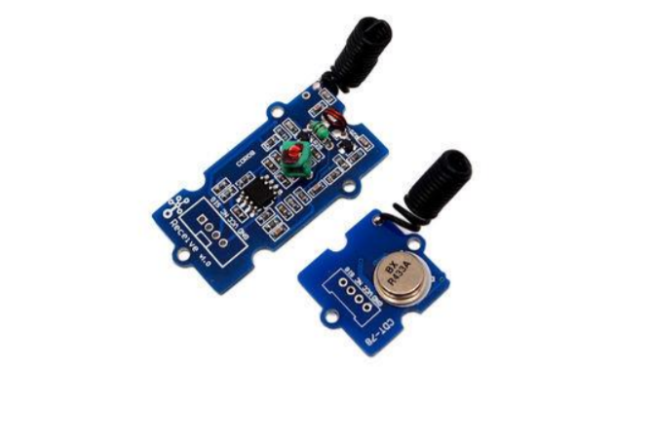
Wirless Transmitter – Reciever RF 433 MHZ

Slide 3
.
Introduction
This kit is used for one way wireless communication at a frequency of 433MHz and includes
transmitter module and a receiver module. The twig configuration of this kit allows for around 40 meters of transmitting distance indoors, or around 100 meters outside.

Slide 4
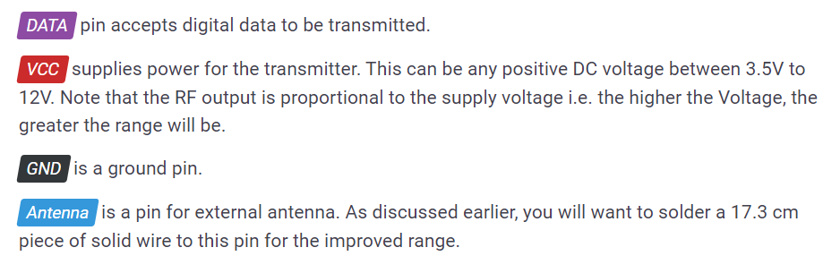
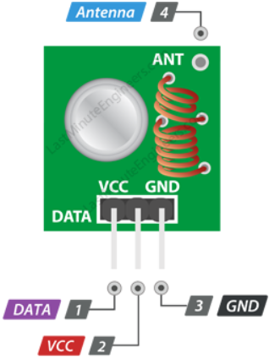
.
Configuration
Transmitter Kit
Transmitter frequency range 433.92MHz

Slide 5
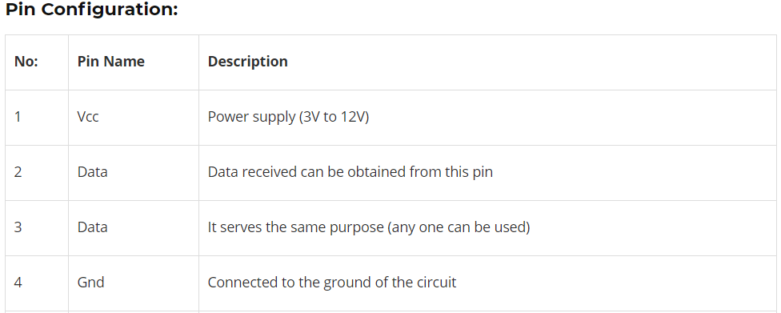
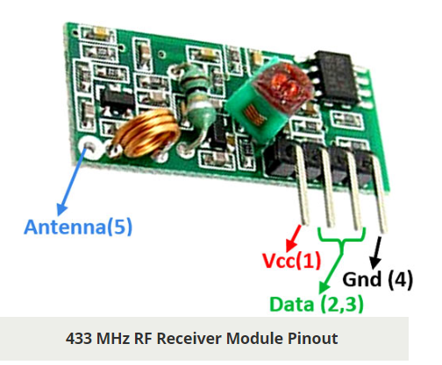
.
Reciever Kit
Receiver frequency 433MHz
Receiver supply current 3.5mA
Low power consumption

Slide 6
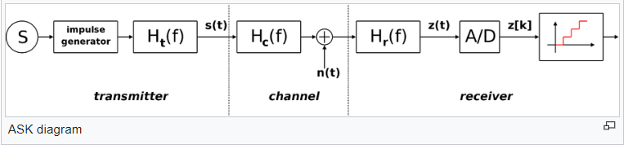
.
Features
1) Modulating Technique: ASK (Amplitude shift keying)
is a form of amplitude modulation that represents digital data as variations in the amplitude of a carrier wave.
ht(f) is the carrier signal for the transmission
hc(f) is the impulse response of the channel
n(t) is the noise introduced by the channel
hr(f) is the filter at the receiver

Slide 7
.
2) GROVE compatible interface
The Grove System is a physical standardization of various electrical interfaces including but not limited to I2C, SPI, UART, GPIO, and analog connections.
In our Project we use UART Interface.
3) One way communication
In one-way communication, information is transferred in one direction only, from the sender to the receiver. There isn't any opportunity for the receiver to give feedback to the sender.

Slide 8
.
Applications
Wireless security systems
Car alarm systems
Remote controls
Sensor reporting
Automation systems

Slide 9
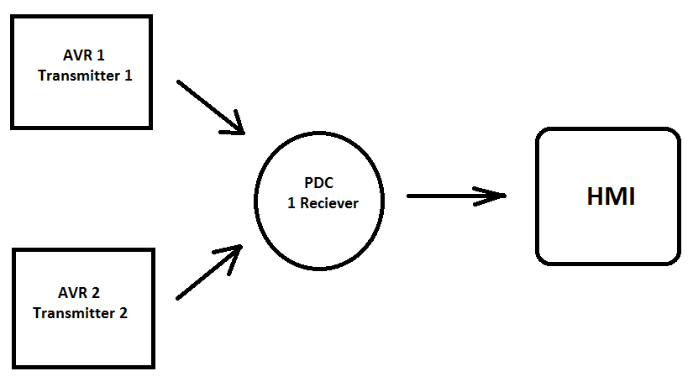
.
Usage
In our project we have 2 Transmitter and 1 reciever

Slide 10
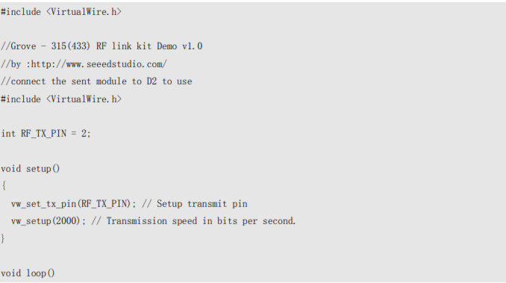
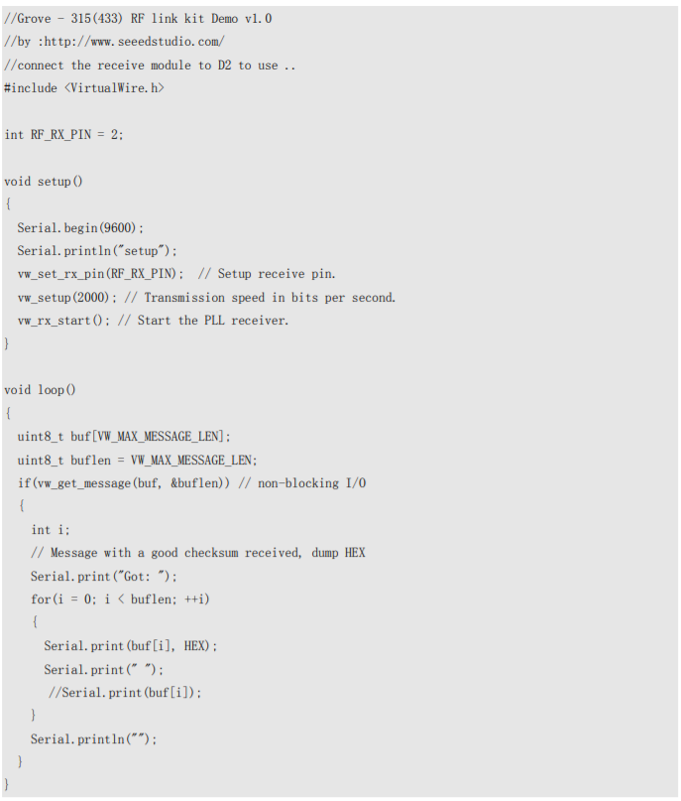
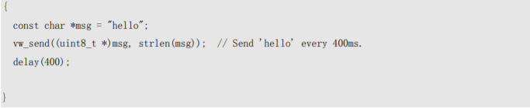
.
Coding
Upload the code below for transmitter module Upload the code below for receiver module:

